Slide 1
CCS Update May 5th 2022
Michael Pyrcz, Laaiba Akmal, Miseal Morales, Dr. Eduardo Maldonado Cruz, Midé Mabadeje
Murray Christie, Vladimir Robinovich, Toby Burrough, Samuel Chambers, Allison Gilmore, etc.
The University of Texas at Austin and S&P Global

Slide 2
Goals
Robust Data Analytics and Machine Learning Workflow for Basin-Scale Carbon Storage Potential
Challenges:
Combining multiple data sources e.g., multiple well log runs, changes in normalization, anomaly detection
Domain expertise driven-insights, e.g, big data analytics, and visualization.
Improved feature selection, e.g., what matters? Focus professional time and data collection.
Robust mapping of carbon storage potential, e.g., reliable, automated spatial predictions.
Improved data analytics for new insights and optimum development.

Slide 3
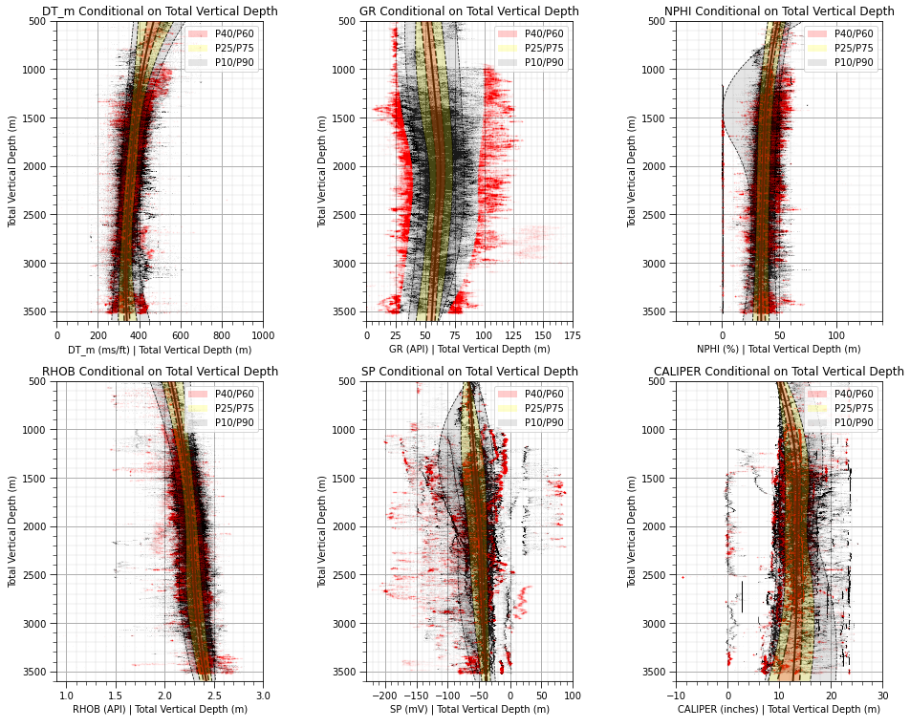
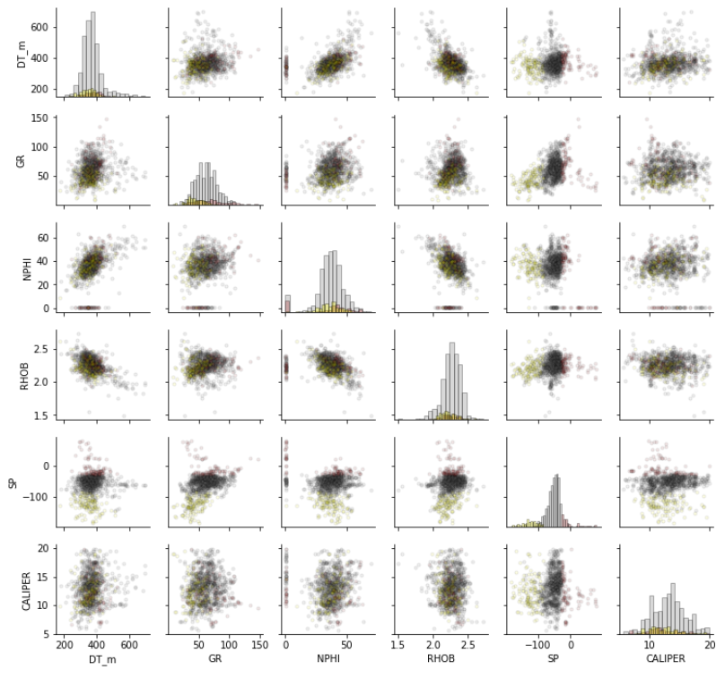
Previous Work
Data analytics, summarization and visualization
Imputation and prediction models that integrate various information sources over multiple scales
Sand / shale prediction model results over all well logs.
Trend dection with filtered well data depth conditional distributions.

Slide 4
Spoiler Alert
Each graduate student was selected to join this project due to their emerging and established expertise in synergistic topics
Students have received well logs from a saline aquifer block from S&P Global
There are data issues, e.g., multiple well runs with inconsistent datums, etc.
We haven’t found the silver bullet, but each student has:
prototyped novel solutions on realistic synthetic and/or S&P Global data
developed educational content and codes to share to support S&P Global

Slide 5
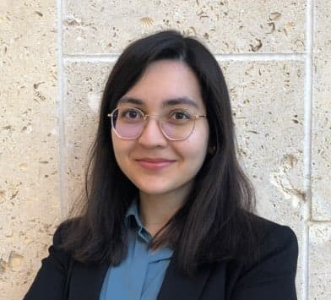
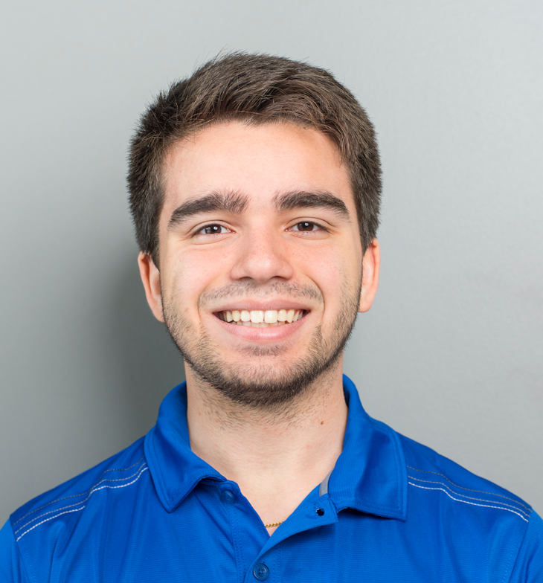
The Graduate Students
Laaiba Akmal (2nd Year MSc)
Discrepency modeling to combine physics and machine learning.
Supervisor: Dr. Pyrcz
Misael Morales (3rd Year PhD)
Deep learning-based models in feature space and methods for lower dimensional representation
Supervisor: Dr. Pyrcz and Dr. Torres-Verdin

Slide 6
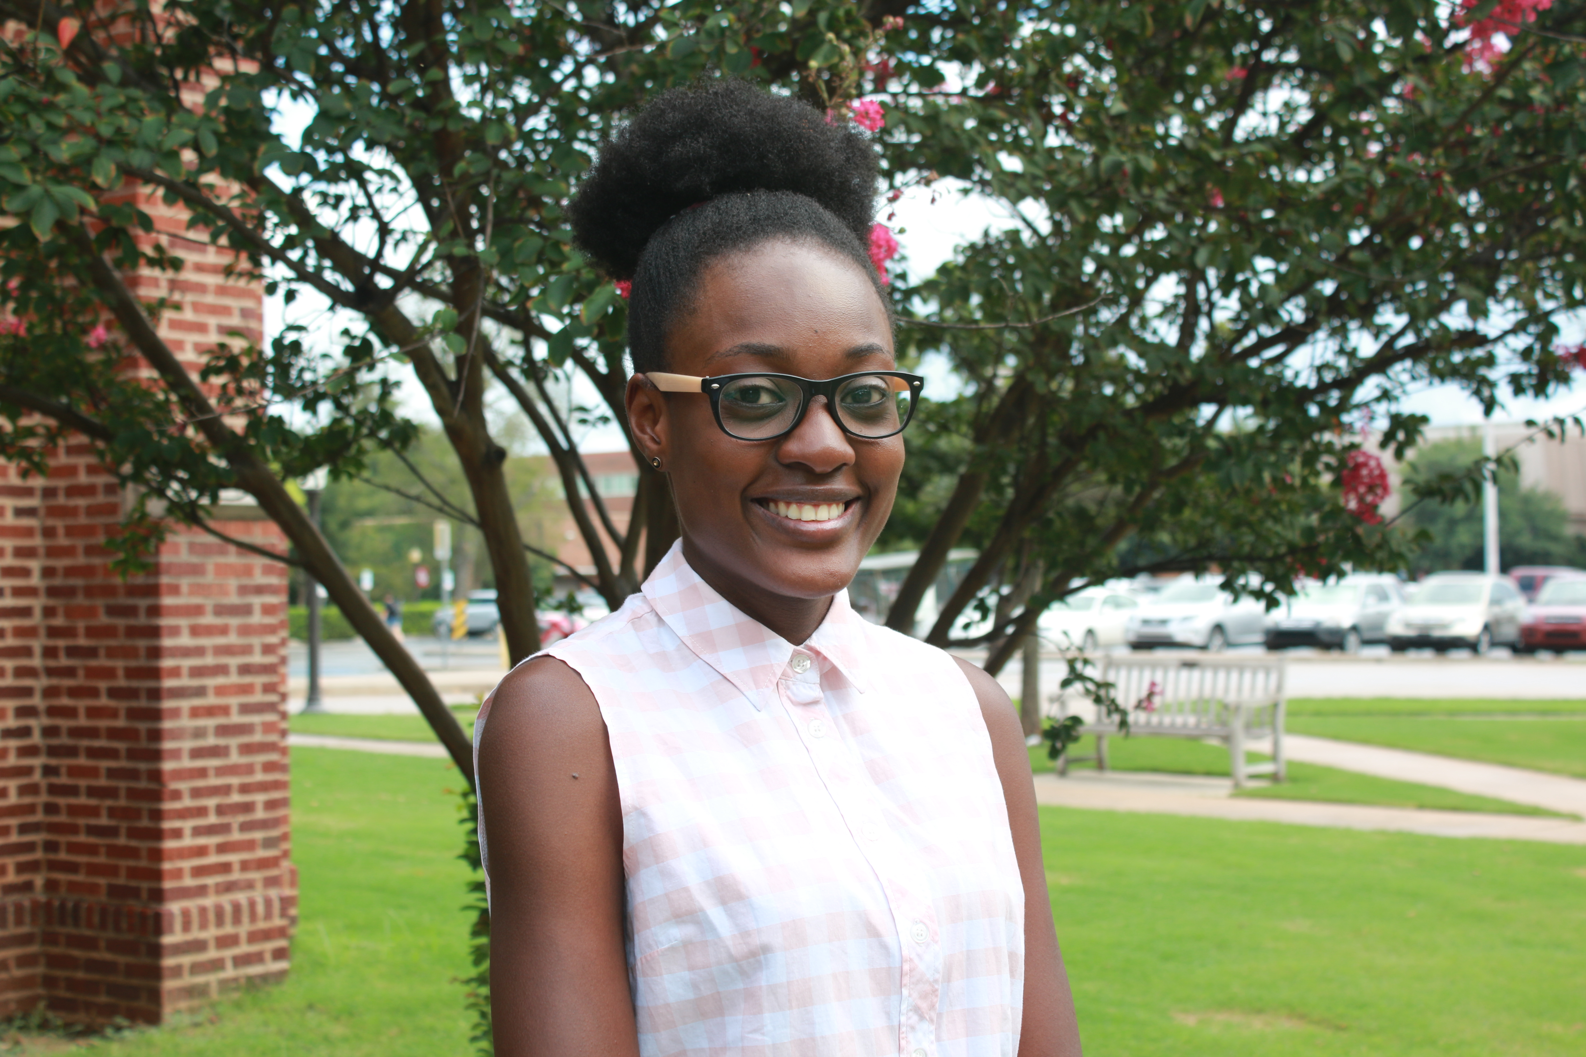
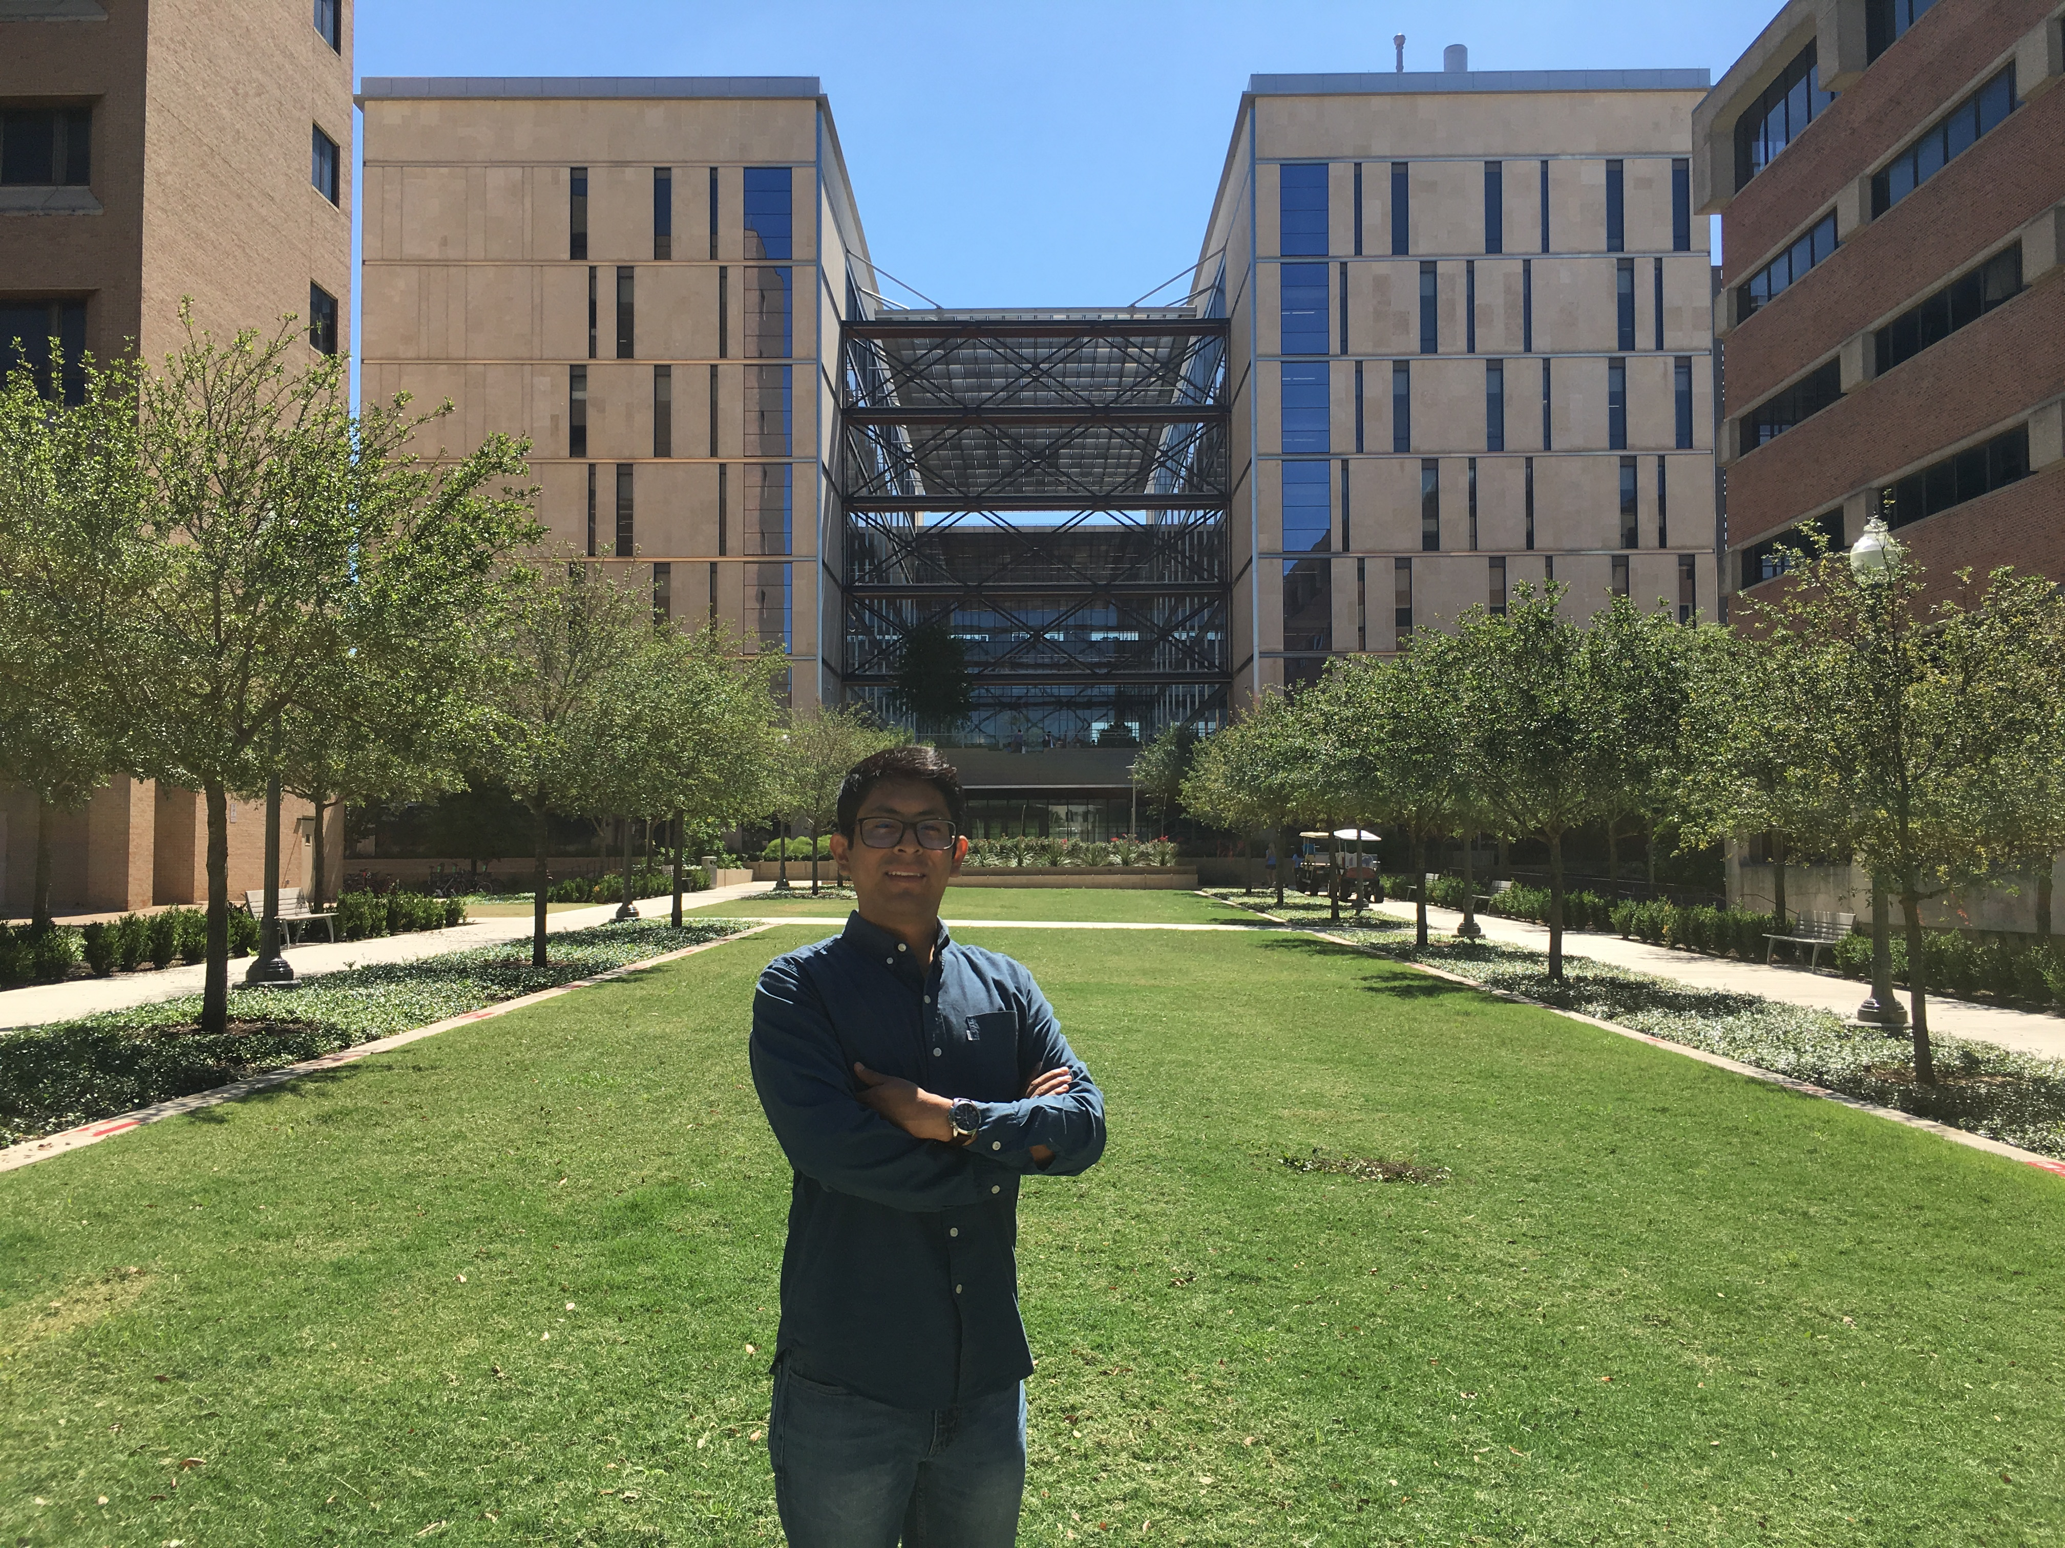
The Graduate Students
Midé Mabadeje (4th Year PhD, MSc Stats Just Completed)
Modeling is lower dimensional latent feature space, mitigating data bias.
Supervisor: Dr. Pyrcz
Dr. Eduardo Maldonado Cruz (Graduated Yesterday)
Generalizable machine learning-based surrogate models for flow forecasting and machine learning uncertainty models.
Supervisor: Dr. Pyrcz

Slide 7
Feedback May 2023
Reminder from Murray, job #1 is to predict thick, continuous sand, job #2 is to predict continuous shale for seals
Consider these sands and shales as end members, then this becomes anomly detection
Interest in Mide’s anomaly detection in low dimensional, latent feature space for Jesse’s fault detection

Slide 8
Feedback December 2022
Machine learning model to predict sand and shale facies for automated classification of facies from well data
Modeling of SP/GR trends by-facies
Assess opportunities for dimensionality reduction, inferential machine learning
GR Normalization issue with every well, by logging run. Use wells nearby to detect, raster assist? Goal is to find best sand.
Identify baseline trends and baseline shifts,
Autoencoder, RNN detect artifacts (GR shifts) using multiple logs.
Discrepancy modeling, use physics + ML to impute and detect anomaly in well logs.
Spotfire to Python and R. Still use workbooks.
Step 1 – detect shifts, using spatial, then try mutlivariate (density, resistivity is best is best for shifts)
Step 2 – simple offset, or just detect the big sand, confident it is not a baseline shift! Image, CCS SPE conference.

Slide 9
Thank you! Any Questions?

